Slide 1
Our Journey Through the Solar System
By: Krysta Kornack
ED 205-02

Slide 2
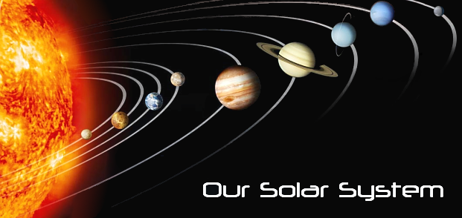
Lets take a trip to outer space!
The Sun
Mercury
Venus
Earth
Mars
Resources
Jupiter
Saturn
Uranus
Neptune
Pluto
Click on the picture above to visit the NASA website!
Quit

Slide 3
THE SUN
The Sun is the largest object in our solar system.
The Sun is 70% hydrogen, 28% helium, and everything else is about 2% (metals).
The temperature of the Sun’s core is 15.6 million Kelvin!
The Sun has eight planets orbiting it along with thousands of smaller objects.
Click on the Sun to watch a video!
Quit

Slide 4
MERCURY
Mercury is the closest planet to the Sun.
Mercury rotates three times in two of its years.
The temperature of Mercury is 90 Kelvin to 700 Kelvin.
The surface is cratered heavily, similar to our Moon.
Mercury has no known satellites.
Quit

Slide 5
VENUS
Venus is the second planet from the sun.
It is the brightest object in our sky besides the Sun and the Moon.
Venus is composed mostly of carbon dioxide, which makes it unsuitable for life.
Venus is also said to be Earth’s sister planet because they are quite similar in all aspects.
Usually Venus is visible to the naked eye because it is the brightest star in our sky.
There are no known satellites that Venus has.
Quit

Slide 6
EARTH
Earth is the third planet from the Sun.
There are many different layers that Earth is divided into.
The Earth is the densest body in the solar system.
71% of Earth is covered by water.
The atmosphere is made up of 77% nitrogen and 21% oxygen with other traces of argon, carbon dioxide and water.
Earth has one satellite, the Moon.
Earth is the only planet right now where life can survive.
Quit

Slide 7
MARS
Mars is the fourth planet from the Sun.
Referred to as the Red Planet.
There’s evidence of erosion on Mars from floods and river systems that has been continuing for 4 billion years.
Mars is similar to Earth, but is much, much colder.
Mars has two satellites, Phobos, and Deimos.
Quit

Slide 8
JUPITER
Jupiter is the fifth planet from the Sun and the largest planet.
It is the fourth brightest object in the sky.
Jupiter is 90% hydrogen and 10% helium, which is considered a gas planet.
Jupiter has a Great Red Spot that is big enough to hold two Earth’s. This Great Red Spot is known to be much colder than the rest of the planet.
Jupiter has sixty-three known satellites.
Quit

Slide 9
SATURN
Saturn is the sixth planet from the Sun, and also the second largest.
It is made of 75% hydrogen and 25% helium, which is similar to Jupiter.
There are two prominent rings that can be seen from Earth that are around Saturn.
These rings are composed of very small particles, like water ice.
Saturn has thirty-four known satellites.
Quit

Slide 10
URANUS
Uranus is the seventh planet from the Sun.
This planet is composed mostly of rock and various ices.
Uranus has a blue tint to it because it absorbs red light.
Uranus has eleven known rings, but they are very dark and composed of large particles.
There are twenty-one named moons, and six unnamed ones.
Uranus rotates parallel, unlike the other planets that rotate perpendicular.
Quit

Slide 11
NEPTUNE
Neptune is the eighth planet from the Sun.
Sometimes, Pluto’s orbit crosses Neptune’s, making Neptune the furthest planet from the Sun.
It has a similar composition of Uranus, rock and ice, and also has the same blue tint as Uranus.
Neptune is known for its Great Dark Spot which is half the size of Jupiter’s Great Red Spot.
There are also rings on Neptune, but they are described as faint arcs.
There are thirteen known moons, seven named ones, plus five more that have yet to be named.
Quit

Slide 12
PLUTO
Pluto is now known as a “dwarf planet” since it orbits far beyond Neptune’s orbit, and is the smallest of all the planets.
Its composition is about 70% rock and 30% water ice.
There is one satellite that Pluto has, Charon.
Quit

Slide 13
RESOURCES
http://www.nineplanets.org/
http://www.youtube.com/watch?v=7dfKoPsA8KQ
http://www.nasa.gov/
Quit

Slide 14
About the Author
Krysta Kornack grew up in Warren, MI, but currently is attending Grand Valley State University and is entering her fourth year as a student. When she graduates college and finally gets a career in teaching, she plans on teaching Integrated Science for Elementary School.
E-mail me!
Quit

