Slide 1
LIGHT AND SHADOW
Grade 5

Slide 2
LIGHT
The brightness that comes from the SUN, FIRE, etc

Slide 3
Light Source

Slide 4
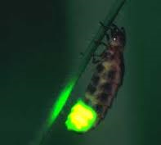
Light source
Fireflies
Glow worm

Slide 5
Not source of light / Reflect light only

Slide 6
How does the moon reflect light

Slide 7
There are 3 types of materials
Transparent materials let light pass through them in straight lines
Glass * Baggie
crystal
Translucent materials let some light through
Tissue paper * Waxed paper
Frosted glass *white paper
Opaque materials do not let any light pass through them
*Wood *cardboard *black paper

Slide 8
Characteristics of light
Light travels in straight line
Light can be reflected
Light can be bent / refracted

Slide 9
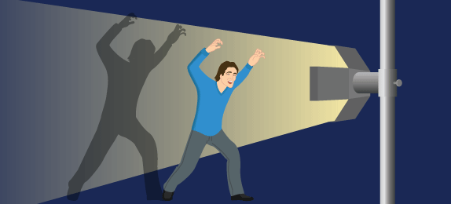
SHADOW
A shadow is made when an object blocks light.
Light travels in straight line, so if it is blocked there must be shadow formed

Slide 10
The object must be opaque or translucent to make a shadow.
A transparent object will not make any shadow, as light will pass straight through it.

Slide 11
Shadow made by sun
Early morning - the Sun is low in the sky and casts a long shadow

Slide 12
Midday - The Sun is above the tree and casts a short shadow

Slide 13
In the Evening
the Sun is low in the sky and casts a long shadow

Slide 14
If an object is moved closer to the light source, the shadow gets bigger.
If an object is moved further away from the light source, the shadow gets smaller

Slide 15
MAKING SHADOW
Experiment aim: Find the best material to cast a shadow
Things you need:
transparent plastic - Black paper
Tissue paper - Torch /flashlight
White paper
Procedures :
Draw the shapes onto 1 piece transparent plastic (A) and 2 pieces of paper (B= tissue paper, C=black paper) with the similar shape and size
Put the cut-out shapes one by one under the light
Shine a strong light onto white surface
Prediction:
Which object produces the darkest shadow?______________

Slide 16
Result
Shade following box to show how dark the shadows are.
Conclusion:
Which object produces the darkest shadow?______________
Tell your analysis why it could be happen!__________________________
plastic
Tissue
Black paper

Slide 17
Conclusion
Black paper is the best material to cast the darkest shadow, because it is dark and opaque so it won’t let any light pass trough and block more light then others.

